Slide 1
Announcements
Website: cs595g.lockshaw.io
Challenge Expectations
Remaining Course Overview

Slide 2
Heap Exploitation

Slide 3
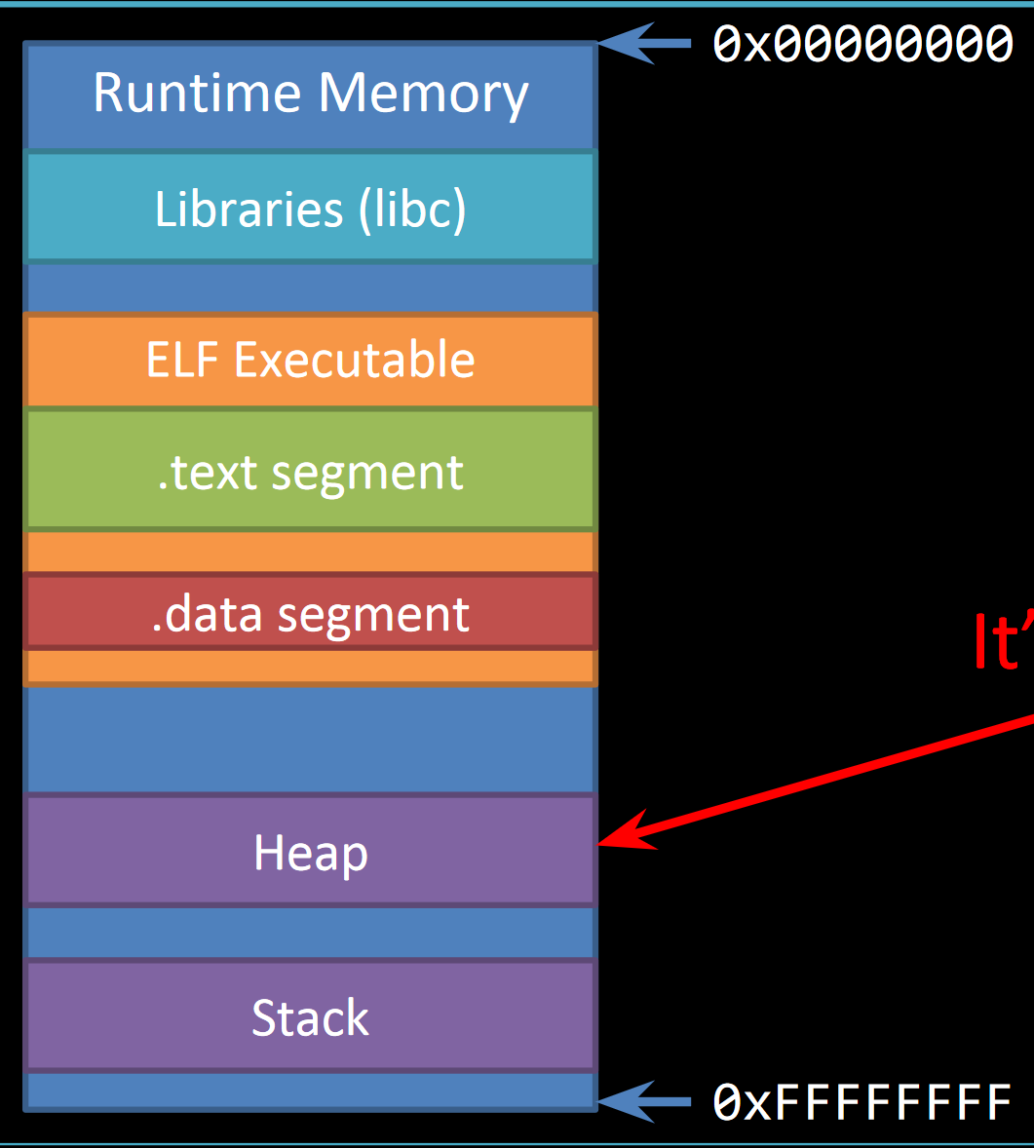
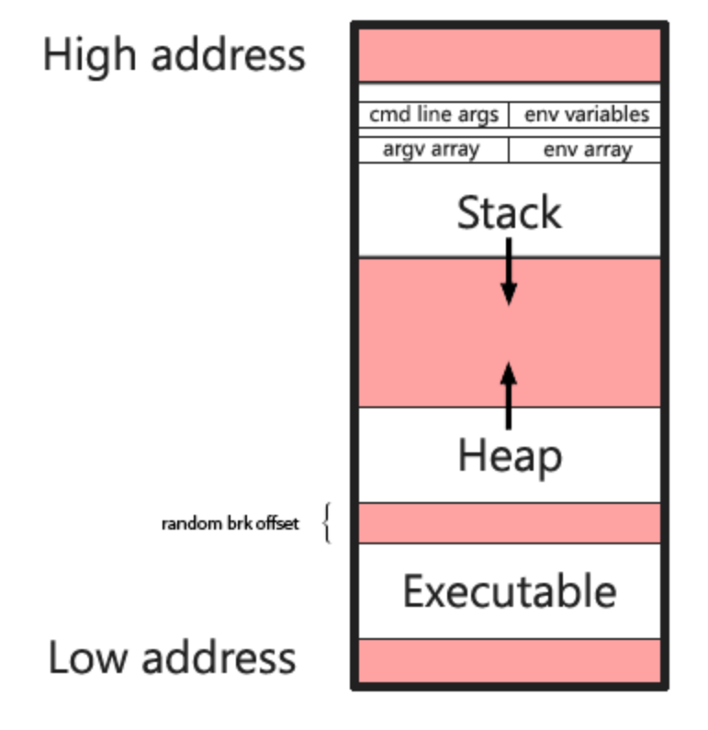
The Heap
malloc, free

Slide 4
Heap Goals
Fast
Fragmentation
Thread Safety
Space-Efficient

Slide 5
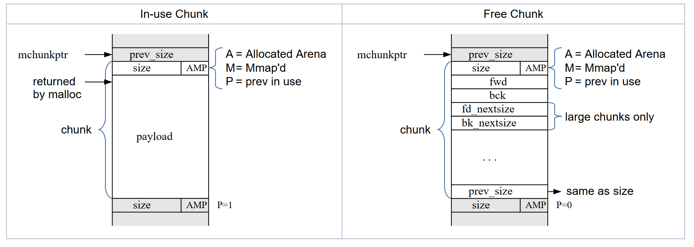
Chunk Layout

Slide 6
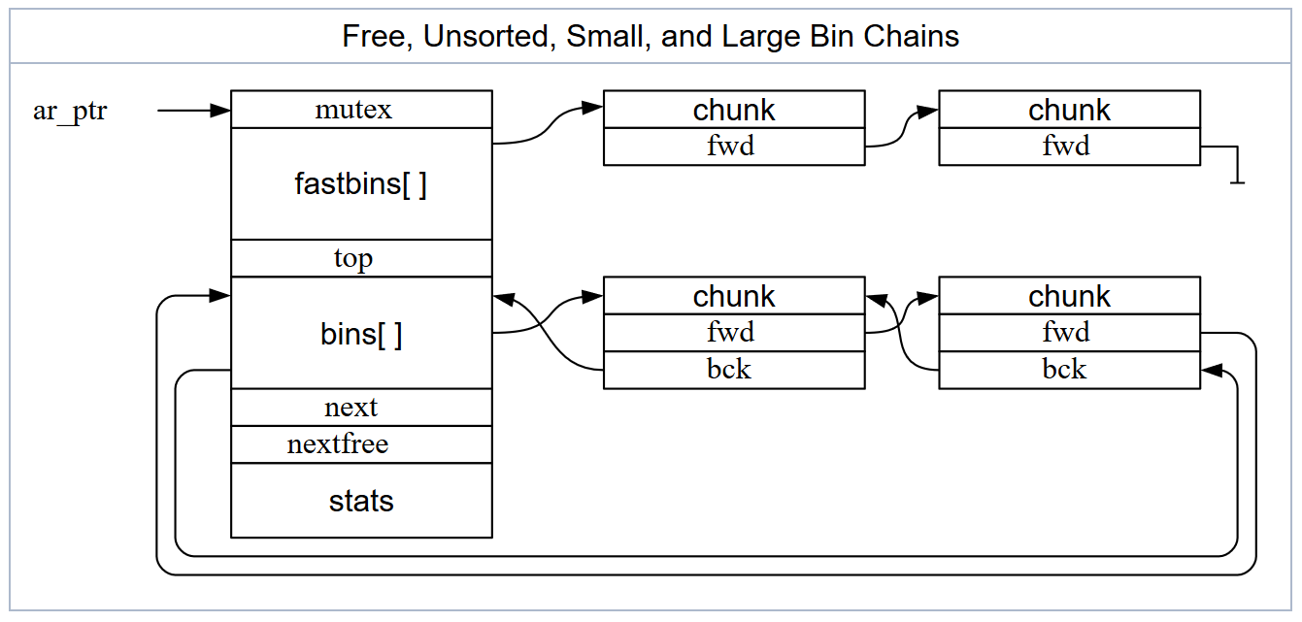
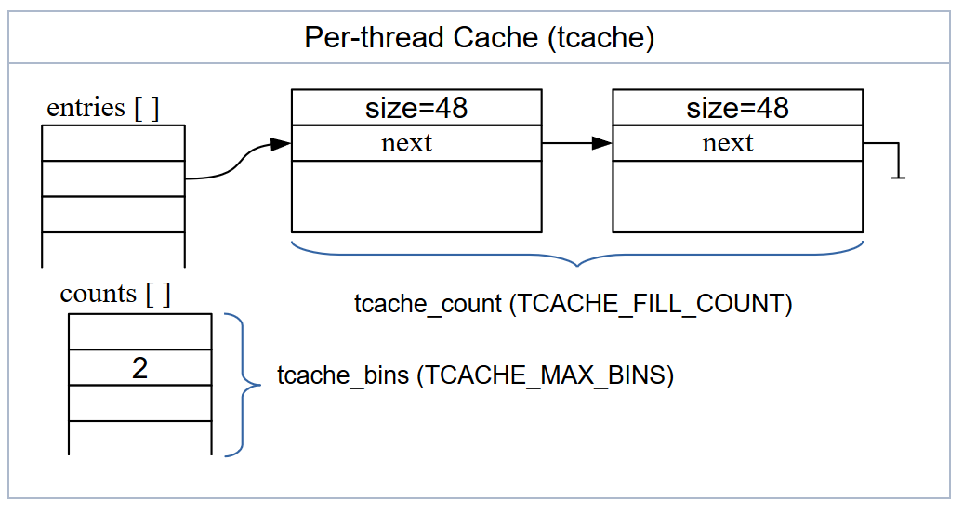
Bins
Fastbins
Smallbins
Largebins
Unsorted Bin
Tcache

Slide 7
Breaking the Heap
Goal:
Arbitrary write
General Strategy:
Corrupt Next (fd), Prev (bk) pointers
Corrupt Size header

Slide 8
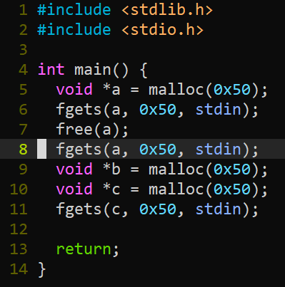
Use After Free (UAF)

Slide 9
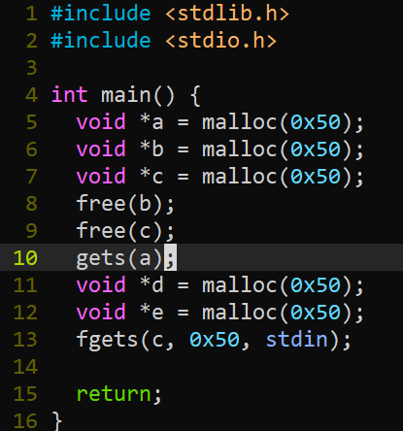
Heap Overflow

Slide 10
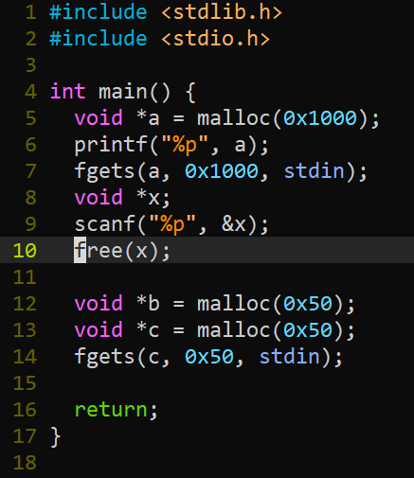
Forging Chunks

Slide 11
Now What?
__malloc_hook
__free_hook
GOT
FILE *
Any other function pointers

Slide 12
Tools
Pwngdb (link on website)

